Slide 1
May 14, 2026
Autonomous Vehicle Perception
Presented by :
Ahmed, Amr, Basel, George and Mohamed

Slide 2
01
Introduction & Data Foundation
02
Baseline Development & Classical ML
03
Neural Perception & Noise Reconstruction
04
Temporal Feature Engineering
Today’s Agenda
05
Sequential Model Zoo: RNN & GRU
06
Advanced Attention & Transformer Architectures
07
Unified Training & Experimental Framework
08
Evaluation & Robustness

Slide 3
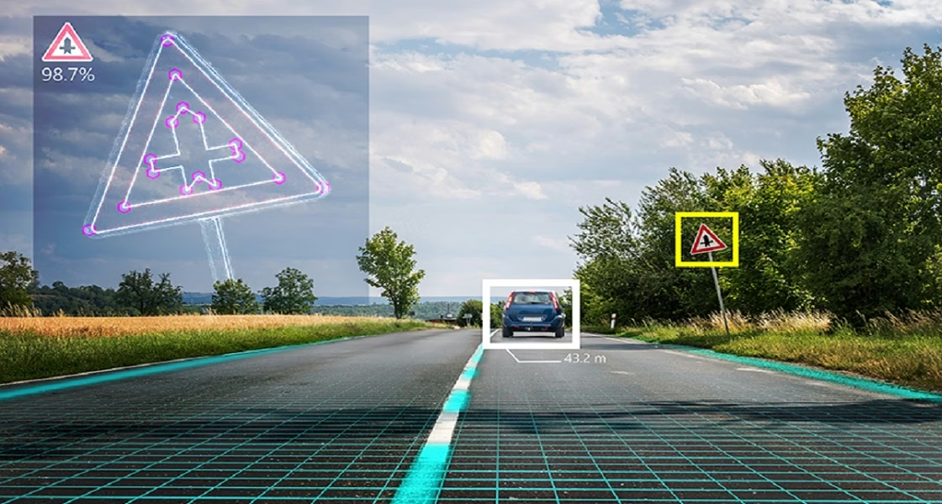
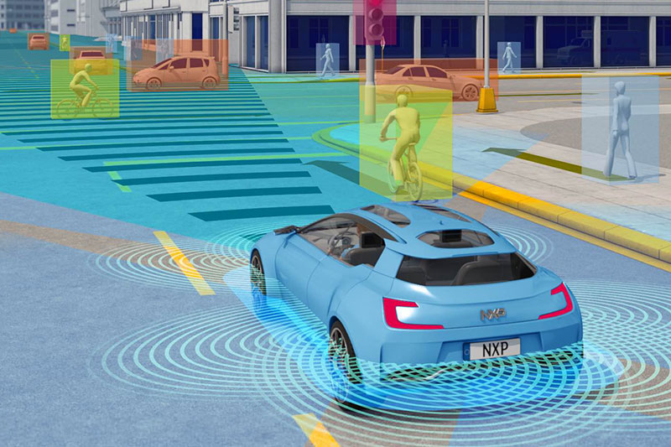
Introduction
AutoVision-Perception is a smart camera system designed to make driving safer. It uses artificial intelligence to watch both the road and the driver at the same time. By detecting road signs, pedestrians, and signs of driver tiredness, the project provides a full safety solution for modern vehicles.
By combining deep learning models with real-time data processing, the system transforms standard camera feeds into an intelligent safety network. This allows the software to react to hazards in milliseconds, ensuring that the vehicle remains aware of its surroundings even when the driver is distracted

Slide 4
Pill 1: Data Foundation
Pill 2: Statistical Baseline
Pill 3: Dimensionality & Search
Perform Exploratory Data Analysis (EDA) on the CIFAR-10, German Traffic Sign (GTSRB), and BDD100K datasets. Analyze class balance, pixel statistics, and feature distributions to identify early challenges in road scene classification.
Establish initial performance benchmarks using KNN and Naïve Bayes algorithms. These classical models serve as the necessary "low-complexity" reference point before moving into deep learning architectures.
Implement PCA for data compression and feature reduction to manage computational load. Use Grid Search for hyperparameter optimization to ensure the baseline models are reaching their peak statistical potential.
Baseline Develoment & Classical ML

Slide 5

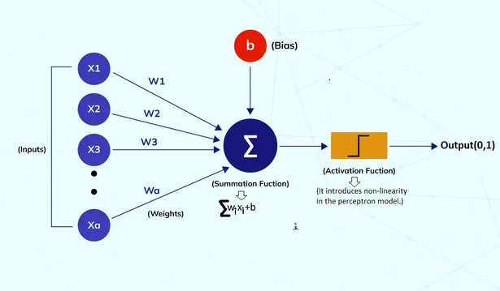
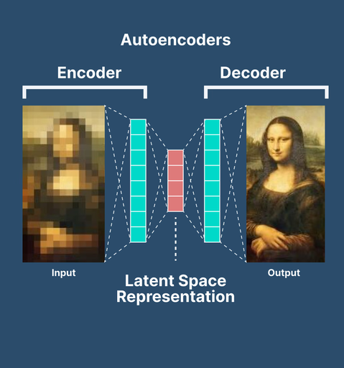
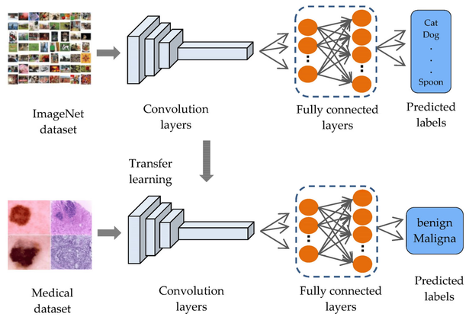
Neural Perception & Noise Reconstruction
01
02
03
Solution
Solution
Solution
Deep Neural Perception
Noise Recovery & Reconstruction
Knowledge Transfer & Optimization
Transition from statistical models to Deep CNNs designed specifically for traffic sign recognition. By stacking convolutional layers, the system learns to extract hierarchical features like edges, shapes, and complex symbols directly from raw pixels.
Implement AutoEncoders to handle real-world image degradation. This unsupervised learning approach compresses noisy input into a latent representation before reconstructing a "clean" version, ensuring the perception module remains robust in poor visibility.
Leverage Transfer Learning by fine-tuning pre-trained models like MobileNet or VGG for specific in-car camera data. This allows the model to benefit from massive existing datasets while specializing in the nuances of your specific autonomous driving environment.

Slide 6

Temporal Feature Engineering
Servicen 02: Feature Caching & Optimization
To maximize training efficiency, we implement a feature caching system within our preprocessing pipeline. This avoids redundant VGG16 passes, significantly speeding up the unified_trainer.py loop and allowing for rapid iteration across different sequential architectures.
Service 01: VGG16 Feature Backbone
Service 03: 10-Frame Sequence Generation
Implement the feature_extractor_vgg16.py module to convert raw image frames into high-level semantic representations. By freezing the convolutional base of VGG16, we generate fixed 512-dimensional feature vectors that act as the foundational input for our sequential models.
Utilize the sequence_dataset.py and gtsrb_sequence_preprocessing.py utilities to build temporal windows. This process groups 10 consecutive frames into a single tensor, formatted as $(batch, 10, 512)$, allowing the system to learn motion patterns rather than just static shapes.

Slide 7
Vanilla RNN (Recurrent Neural Network)
Gated Recurrent Unit (GRU)
Implement the fundamental base_sequential_models.py RNN class to handle frame-by-frame temporal updates.
Introduce the GRU architecture as a sophisticated alternative to mitigate memory loss in the sequential pipeline.
Analyze the model's ability to maintain a hidden state across the 10-frame sequence window.
Utilize Reset and Update gates to selectively retain information from previous traffic sign frames.
Identify performance bottlenecks, specifically focusing on the vanishing gradient problem during backpropagation through time.
Compare training stability and convergence speed against the vanilla RNN using the unified_trainer.py logs.

Slide 8
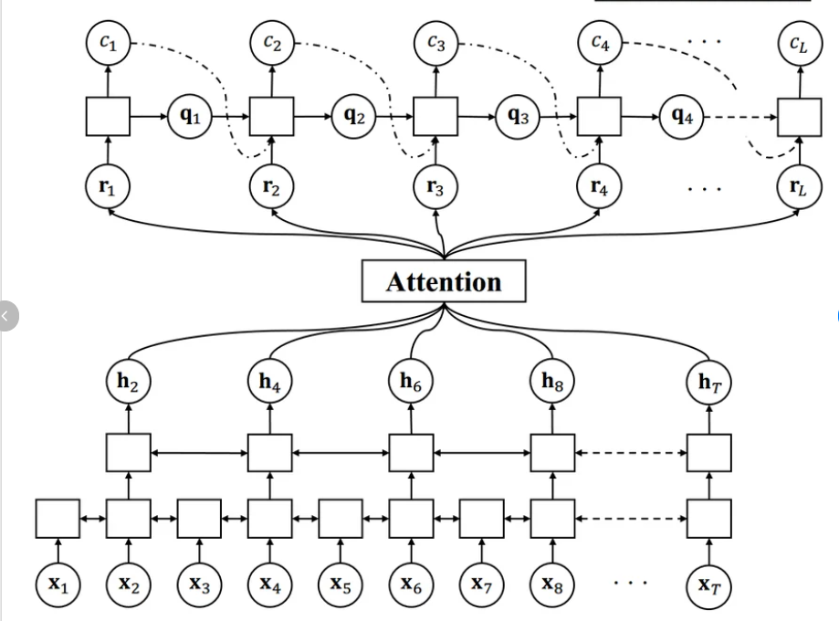
Advantage 01: LSTM with Temporal Attention
We enhance the Long Short-Term Memory (LSTM) network with a custom Attention mechanism. This allows the model to dynamically weigh the importance of specific frames in a sequence, effectively "looking back" at the most relevant past events to inform current road scene classification.
To overcome the memory constraints of traditional sequential models, we integrate attention-based architectures. These models prioritize critical temporal information within the 10-frame sequence, ensuring the system remains focused on high-impact visual features like moving hazards or changing traffic signals.
Advantage 02: Multi-Head Transformer Architecture
By deploying a Multi-head Transformer, we move beyond sequential processing. This architecture utilizes parallel self-attention heads to identify complex, non-linear relationships across the entire temporal window simultaneously, resulting in superior feature representation and faster convergence.
Key Technical Advancements
Advantage 03: Scalable Sequence Processing
These architectures are designed to be highly scalable within our Unified Training framework. The modular implementation allows for seamless integration of larger temporal windows or higher-dimensional feature vectors without degrading inference performance in real-time autonomous environments.

Slide 9

TRAINING LOGIC
To ensure a fair and rigorous comparison, we developed a unified_trainer.py framework. This centralized logic allows for a single training loop to handle all sequential architectures RNN, GRU, LSTM,and Transformers—maintaining consistent hyperparameters and optimization strategies across every experiment.
Centralized config.py for global hyperparameter control.
Automated reports/ generation for model benchmarking.
Optimized trainer_opt.py for GPU resource management.

Slide 10

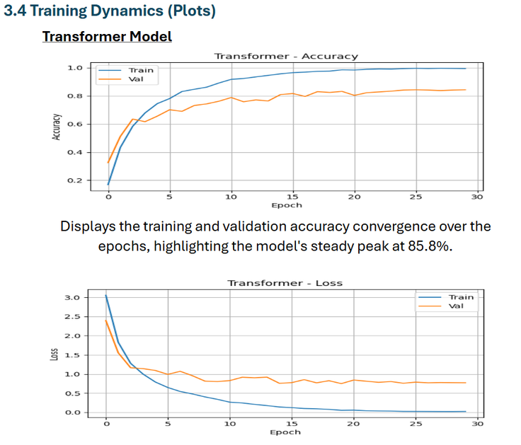
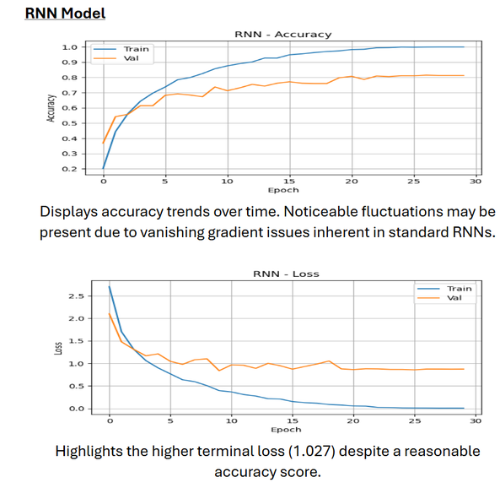
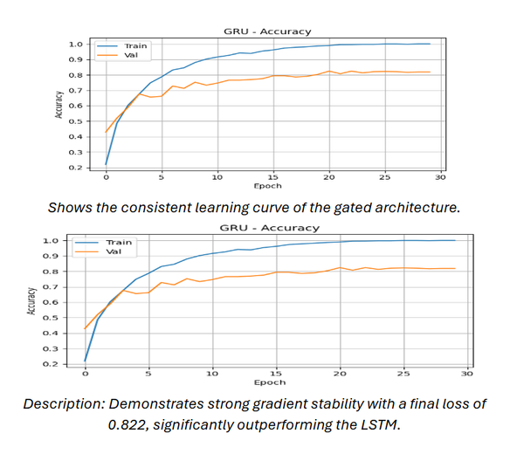
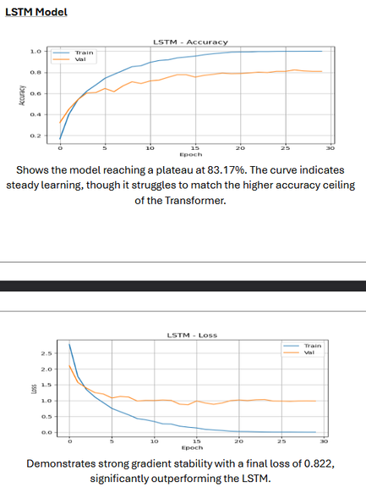
FCAI
Presentation
June 11, 2026
Present
Evaluation & Robustness

Slide 11
FCAI
Presentation
May 14, 2026
Meet Our Team
Mohamed Elkady
George Malak
Ahmed Samir
Amr Khalid
Transformer
RNN
Deployment
GRU
Basel Mohamed
LSTM

Slide 12
May 14, 2026
Thank You
Presented by :
Ahmed, Amr, Basel, George and Mohamed

